Slide 1
Hadoop YARN
Tseng-Ching James Shen PhD

Slide 2
Agenda
Overview of YARN Architecture
Development of Distributed Applications with YARN
Job Scheduling
YARN Availability

Slide 3
Overview of YARN Architecture
Resource Manager
- Resource Management
- Task Allocation
- Task Scheduling
Client App.
Network
Node Mgr
Node Mgr
Node Mgr
- Start containers
- Run a task in one container

Slide 4
Develop a YARN Distributed Job
Your distributed algorithm is implemented as a YARN ApplicationMaster, a Java application which can run on a YARN container
The ApplicationMaster is developed with the YARN API to interact with the Resource Manager and Node Managers to create & run tasks
The ApplicationMaster is packaged in a YARN Client Job, also a Java process which submit the AM to the Resource Manager
APACHE HADOOP YARN, Moving beyond MapReduce and Batch Processing with Apache Hadoop 2, ARUN C. Murphy, Vinod Kumar Vavilapalli etc. Addison-Wesley 2014

Slide 5
YARN Client Job
The client job sends the ApplicationMaster to the Resource Manger via a YARN ApplicationSumissionContext object where the following is defined
The ApplicationMaster jar file
The container specification for the ApplicationMaster job
The Resource Manager looks for one Node Manager to run the ApplicationMaster
Once the Node Manager is identified, the Resource Manager will ask the Node Manager to
Start a container
Run the ApplicationMaster on the container

Slide 6
ApplicationMaster
For each task defined in the distributed algorithm, the ApplicationMaster will send a YARN request to the Resource Manger to find the Node Manager to run the task
Once the Resource Manager sends back the Node Manager, the ApplicationMaster will send YARN requests to ask the Node Manager to
Start a container
Run the task on the container
The ApplicationMaster is supposed to monitor the progress of each task and handle the errors properly

Slide 7
Development Steps
Create a new project and add Hadoop-YARN dependencies
Develop the Application Master and client classes
Export the application to a jar file
Use yarn command to run the application

Slide 8
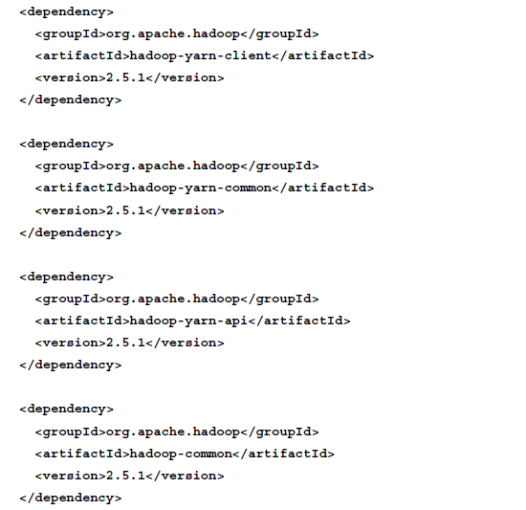
Hadoop YARN Dependencies

Slide 9
Application Master Class
Initialize AMRMClient and NMClient clients
Register the attempt with the ResourceManager
Define ContainerRequest and add container request
Request allocation, define ContainerLaunchContext and start containers
On completion, unregister Application from RM

Slide 10
YARN Client Class
Read YARNConfiguration and initialize YARNClient
Connect to RM and request for new application id
Define ContainerLaunchContext for Application Master
Create ApplicationSubmissionContext
Submit application and wait for completion

Slide 11
Run YARN Application
bin/yarn jar first-yarn-app.jar com.packt.firstyarnapp.Client
/bin/true1 hdfs://master:8020/user/hduser/first-yarn-app.jar

Slide 12
YARN Job Scheduling
FIFO scheduler
Capacity scheduler
Fair scheduler

Slide 13
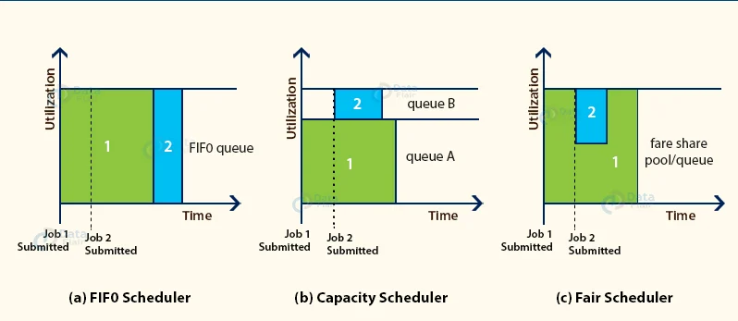

Slide 14
YARN Availability
Failures on the Resource Manager
Resource Manager failover
Failures on the Node Manager
Node Manager running the ApplicationMaster
Resource Manager should detect the failure and take steps to recover
Node Manager running tasks
ApplicationMaster should detect the failure
ApplicationMaster will decide what to do when failures are detected

